Slide 1
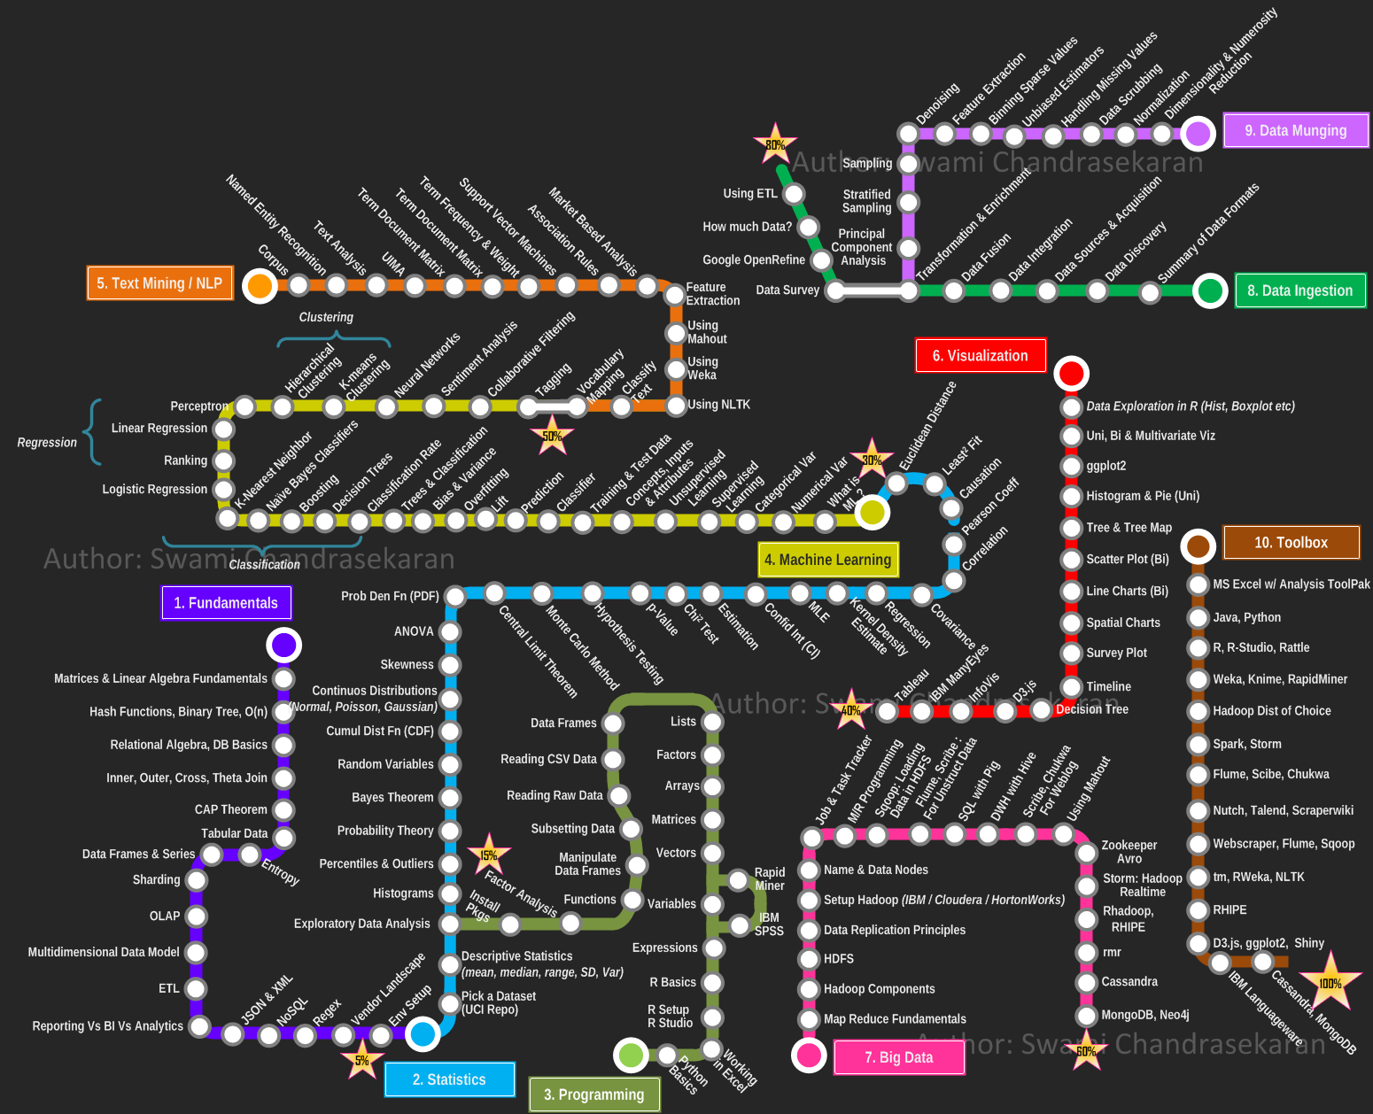

Introduction to Predictive Analytics in Cancer
APPLIED CLINICAL ANALYTICS

Slide 2




DATA ANALYTICS IN HEALTHCARE & LIFE SCIENCES
Descriptive
Predictive
Prescriptive
BUSINESS PROBLEMS
DATA SOURCES
ACTIONABLE INSIGHTS
ANALYTICS ALGORITHMS
VITAL BUSINESS PROBLEMS: So many different problems exist and they are of varying degree of complexity: - What impacts favorable clinical outcomes - Drivers of adverse events - Factors impacting cost of care - Earlier diagnosis of cancers and chronic diseases Understanding these different business problems is critical for generating possible solutions
POTENTIAL DATA SOURCES: Huge amounts of data is getting generated nowadays from different sources that are capable of capturing information : - Electronic Health Records - Healthcare claims from Insurance companies - Pharmacies – claims and medication reviews - Lab tests and Imaging results - Population health data – Social Determinants of Health - Genomics (and later Proteomics and Metabolomics) - Wearable and other devices - Other sources (Surveys, Patient Reported Outcomes) The volume, velocity, variety, and veracity that is getting generated is staggering – typical Big Data problem.
DATA PROCESSING, MANAGEMENT AND ANALYSIS: Making sense of these varied sources of data and processing them so that they are useful for analysis is a data engineering challenge. Structured data needs to be cleaned and curated; data from different sources need to be matched to get a complete 360 degree view of the customer. Semi-structured and unstructured data sources (Physician notes, imaging data) pose challenges to curate and store the information so that it can be retrieved and analyzed at scale and speed. Various Big Data technologies have been developed to tackle this problem of storing(HADOOP ecosystem, SPARK) and analyzing semi-structured and unstructured data (Text mining, NLP, Deep Learning for Image and Video Analytics).
SOLUTIONS TO THE PROBLEMS: At the end of the day, all the analysis should be able to generate actionable insights. Interpretation of the results and their implementation to solve the problem are key.

Slide 3
HOW ML/DL CAN AUGMENT THE DECISION MAKING PROCESS FOR CLINICIANS
PROGNOSIS
A machine-learning model can learn the patterns of health trajectories of vast numbers of patients. This facility can help physicians to anticipate future events at an expert level, drawing from information well beyond the individual physician’s practice experience. For example, how likely is it that a patient will be able to return to work, or how quickly will the disease progress?
DIAGNOSIS
A diagnostic error will occur in the care of nearly every patient in his or her lifetime, and receiving the right diagnosis is critical to receiving appropriate care. This problem is not limited to rare conditions. Cardiac chest pain, TB, dysentery, and complications of childbirth are commonly not detected even in developing countries
TREATMENT
In a large health care system with tens of thousands of physicians treating tens of millions of patients, there is variation in when and why patients present for care and how patients with similar conditions are treated. Can a model sort through these natural variations to help physicians identify when the collective experience points to a preferred treatment pathway?
REMOTE AREAS
CLINICAL WORKFLOW
The same machine-learning techniques that are used in many consumer products can be used to make clinicians more efficient. Machine learning that drives search engines can help expose reqd. .information in a patient’s chart for a clinician without multiple clicks. Data entry of forms and text fields can be improved with the use of machine-learning techniques.
There is no way for physicians to individually interact with all the patients who may need care. Can machine learning extend the reach of clinicians to provide expert-level medical assessment without involvement? For example, patients with new rashes may be able to obtain a diagnosis by sending a picture that they take on their smartphones, thereby averting unnecessary urgent-care visits.
REFERENCE: https://www.nejm.org/doi/full/10.1056/NEJMra1814259

Slide 4











COMPONENTS OF ELECTRONIC HEALTH RECORDS
EMR
DEMOG &
HISTORY
DRUGS
ALLERGIES
VISITS
PROCEDURE
ADMISSIONS
DIAGNOSES
LAB RESULTS
STANDARD EMR/EHR DATA COMPONENTS
DEMOGRAHICS – Age, Gender, Race, Language, Religion, Insurance, Location
CLINICAL HISTORY – Habits, Past Dx and Observations
MEDICATIONS – Drug NDC, Quantity, Refills, Route, Rx dates
FOOD AND DRUG ALLERGIES – Allergen, Reaction Desc., Severity, Dates
VISITS TO ER AND OPD – Date/Time, Encounter Type, Provider Info
INPATIENT ADMISSIONS – Date/Time, Source, Discharge Code
PRIMARY DIAGNOSES AND COMORBIDITIES – ICD9/10, SNOMED
PROCEDURES AND SURGERIES – Procedure codes and ICD codes
LABORATORY RESULTS – LOINC, Date/Time, Reference Range, Value, UOM
Standard dictionaries: ICD9/10, SNOMED-CT, NDC, LOINC, NPI
ADDITIONAL DATA FACTORS (normally not present)
GENOMICS
SOCIAL DETERMINANTS OF HEALTH
IMAGING DATA – X-RAY/USG/CT/MRI
PATIENT REPORTED OUTCOMES - PRO
GENOMICS
IMAGING
SDoH
OUTCOMES

Slide 5
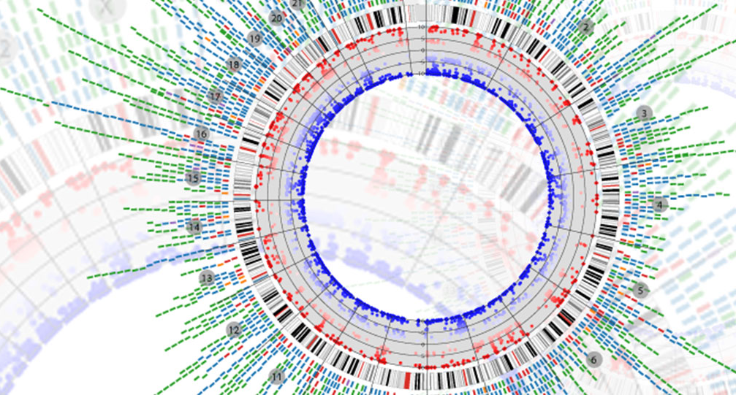
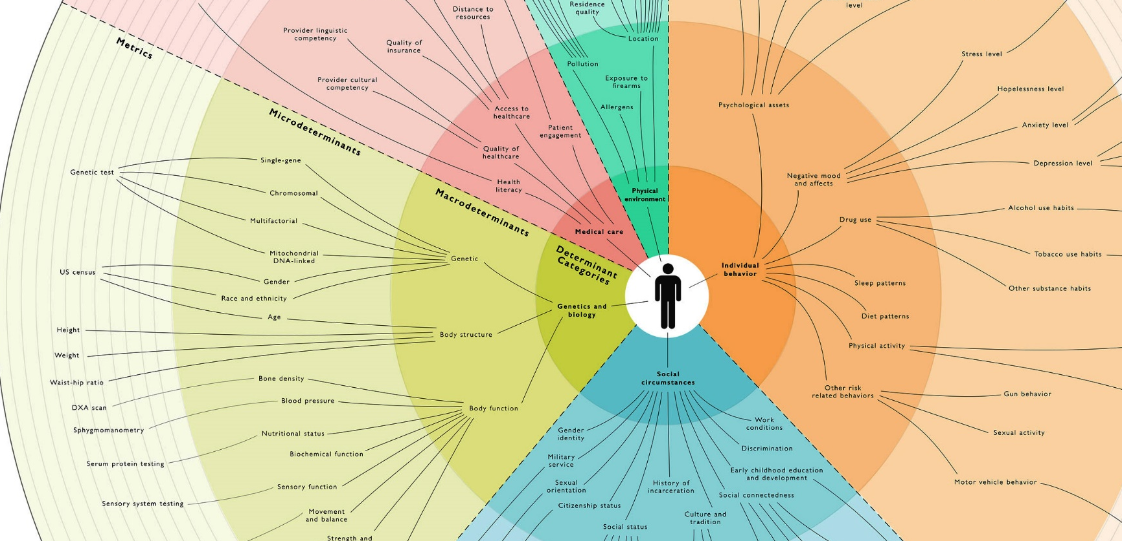
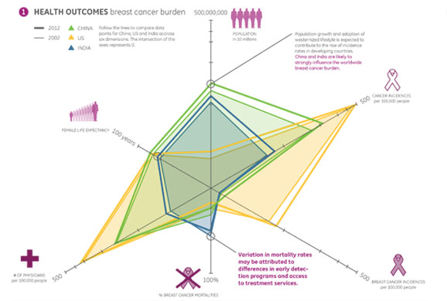
COMPLETE PICTURE - POSSIBLE DATA SOURCES
GENOMIC DATA
Huge volume and different arrays of genomic data are available related to cancer. Some of the are as below:
Chromosomal abnormalities
Acquired mutations characterization
Cancer risk factors and their genetic basis (Smoking and Lung Cancer )
DNA Microarrays:
Differential expression for diagnosis
Treatment response
Cancer progression
SOCIAL DETERMINANTS
Social Determinants of Health are the conditions in which people are born, grow, live, work and age.
Broadly they can be as below:
Socio-economic status and Family Income
Educational status
Job security, Working conditions
Early childhood development
Food and housing conditions
Social Inclusion/Exclusion
Social Safety network
Disability status
Healthcare services and accessibility
CLINICAL OUTCOMES
Most EHR systems have very detailed clinical information about encounters, but they lack clear clinical outcomes related information. Important outcomes related information can be as follows:
Cure/remission – tracking of symptoms vs serum tumor markers
Hi-Res Imaging techniques
Patient Reported Outcomes
Various QoL surveys and questionnaires
Functional/Performance Status scales like ECOG and Karnofsky
Palliative care related patient experience

Slide 6
WORLDWIDE ONCOLOGY MARKET TRENDS
NEW CASES AND DEATHS DUE TO CANCER REPORTED IN US
TOP SELLING ONCOLOGY DRUGS GLOBALLY
CAGR: 2%
Company | Drug | Sales | Growth | Cancer treatment (by site)
Roche
Roche
Celgene
Roche
Novartis
Eli Lilly
J&J
Novartis
Novartis
Novartis
10%
10%
16%
6%
-2%
-11%
0%
7%
-1%
2%
Digestive, Breast, Respiratory, Urinary, Genital system
Breast
Myeloma
Lymphoma, Leukemia
Leukemia, Digestive system
Respiratory system
Genital system
Leukemia
Endocrine, Digestive system
Urinary, Breast, Brain & other nervous, Digestive system
CAGR: 1%
millions
Source: Center for Disease Control & Prevention
New cases (in US) - 2016
Deaths (in US) - 2016
Source: pharmaceutical-technology.com
Although the incidence of cancer and related deaths have increased in last decade, rate of increase in incidence has remained constant, while there is a decline in rate of increase in deaths
Although most people suffer from cancer in digestive system, it is the cancer in respiratory system that is responsible for most deaths
The drug market is mainly consolidated by 5 companies (Roche, Celgene, Novartis, Eli Lilly and J&J) that produce the top 10 oncology drugs accounting for 36% of total oncology drug market
Source: American Cancer Society

Slide 7
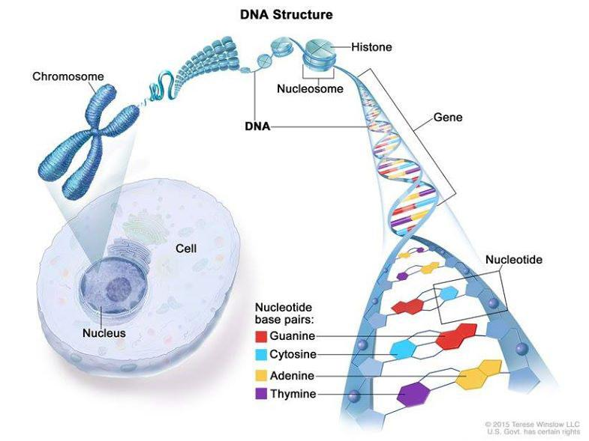
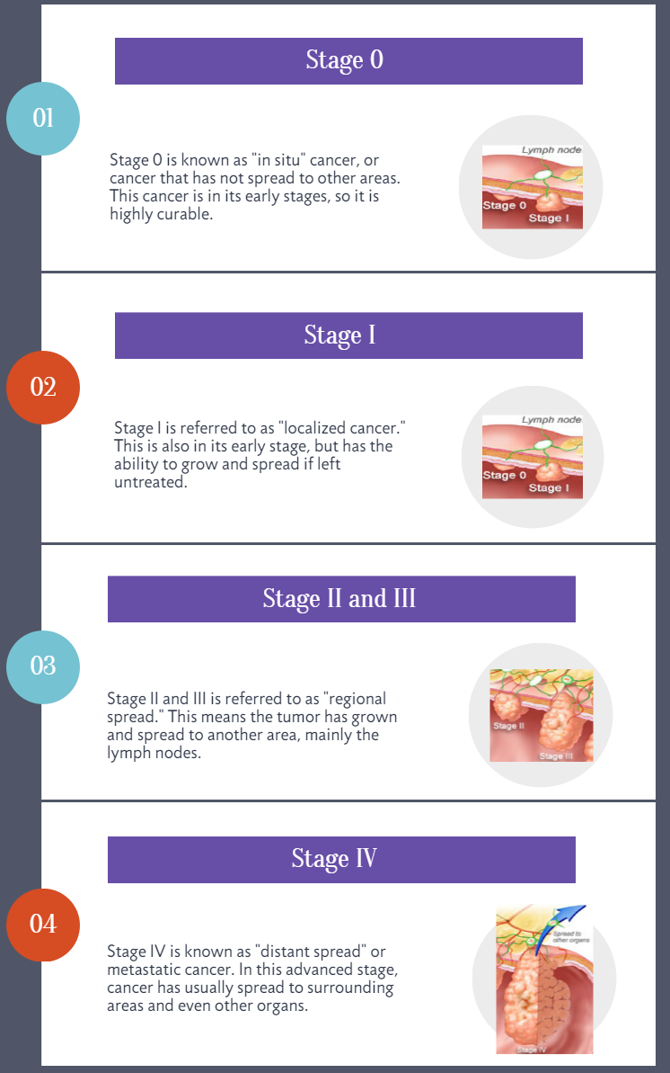
WHAT HAPPENS IN CANCER / TUMOR PATHOLOGY
Video: https://www.youtube.com/watch?v=GhfrHjBX5eA
IMAGE COURTESY: NATIONAL CANCER INSTITUTE and CCCNevada.com
(https://www.cancer.gov/about-cancer/understanding/what-is-cancer)

Slide 8
Breast Cancer – Treatment OPTIONS
5 YR Survival
99%
85%
26%
LOCALIZED
REGIONAL
DISTANT
STAGES
STAGE 0
STAGE 1
STAGE 2
PALLIATIVE
STAGE 3
STAGE 4
SUBTYPES
Estimated new cases in 2016 were 2,46,660 - out of which 5% would be metastatic at time of diagnosis*
Sx + RT + Chemo + HER2
Sx + RT + Chemo + HER2
Chemo + HER2
Sx + RT + Endocrine + Chemo + HER2
Sx + RT + Endocrine + Chemo + HER2
Endocrine + Chemo + HER2
Surgery + RT + Chemotherapy
Surgery + RT + Chemotherapy
Chemotherapy
Endocrine Therapy
+
Chemotherapy
+
Everolimus/Palbociclib
(if post-menopausal)
Surgery (Sx) +
Radiotherapy (RT)
+
Endocrine Therapy
+
Chemotherapy
Surgery (Sx) +
Radiotherapy (RT)
+
Endocrine Therapy
+
Chemotherapy
So in 2016, ~ 12500 new patients were
to be diagnosed with Stage 4 disease, ~60% of whom may be post-menopausal and may benefit from Palbociclib therapy.
*Total number of Breast Cancer patients in US ~ 3 million, 30% of whom will become metastatic eventually at some point (*SEER Data 2015-16)

Slide 9






ROLE OF DATA AND ANALYTICS IN BREAST CANCER
BREAST CANCER PATIENT JOURNEY
TNM
DIAGNOSIS
Information, advice and support
Assessment SEVERITY assessment and staging
treatment
Surgery/Chemo/Radio and adjuvant therapy
complications
Chemotx, radiotx – leads to complications
Follow-up
Continued monitoring of disease progression
1
2
3
4
5
EMR/EHR DATA ELEMENTS
FAMILY HISTORY OF BRCA
RECEPTOR STATUS (ER, PR, BRCA1, HER)
STAGING (AT DIAGNOSIS, CURRENT)
METASTASIS – ONSET AND LOCATION
TREATMENT HISTORY
COMPLICATIONS, ADVERSE EVENTS
ENCOUNTERS (IP, OP, ER)
COMORBIDITIES
BIOMARKERS/TUMOR MARKERS
ADDITIONAL DATA ELEMENTS
GENOMICS
PHYSICIAN NOTES
IMAGING – CT/MRI
TUMOR MARKER RESULTS
CLINICAL FOLLOW-UP
SOCIAL DETERMINANTS OF HEALTH
SURVEYS AND SUPPORT PROGRAMS
CLINICAL OUTCOMES – PATIENT REPORTED OUTCOMES - PRO
BRCA OUTCOMES & ANALYTICS:
RELAPSE PROBABLITY
METASTASIS ONSET
PROGNOSTICATION
HEOR STUDIES FOR REGIMENS
SURVIVAL ANALYSIS
QUALITY OF LIFE PREDICTION
FUNCTIONAL STATUS/ECOG
COST OF CANCER CARE

Slide 10
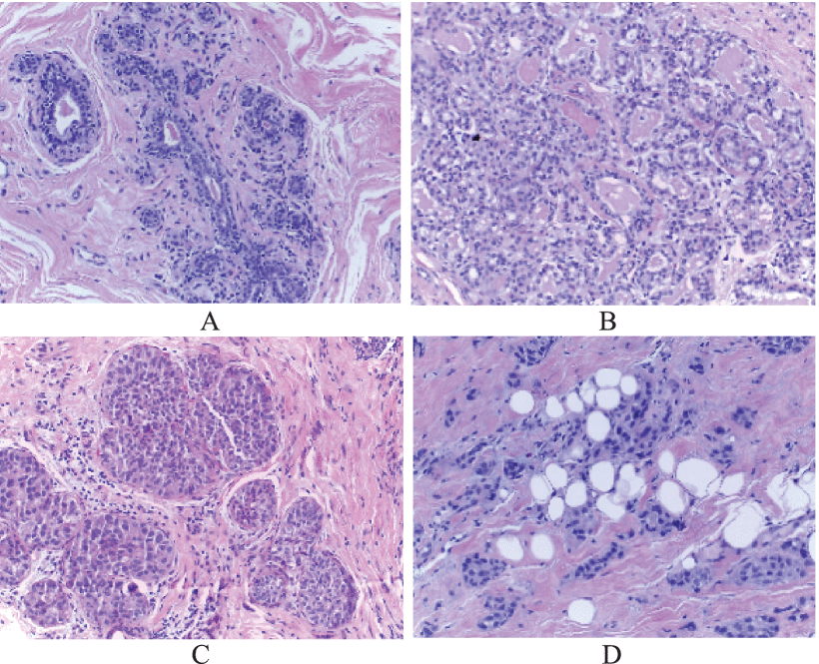
BREAST CANCER HISTOLOGY DATASET - SUMMARY
BREAST CANCER WISCONSIN DATASET – HISTOLOGY ON RESECTED TUMOR
Attribute Information:
1. Sample code number: id number 2. Clump Thickness: 1 - 10 3. Uniformity of Cell Size: 1 - 10 4. Uniformity of Cell Shape: 1 - 10 5. Marginal Adhesion: 1 - 10 6. Single Epithelial Cell Size: 1 - 10 7. Bare Nuclei: 1 - 10 8. Bland Chromatin: 1 - 10 9. Normal Nucleoli: 1 - 10 10. Mitoses: 1 - 10 11. Class: (2 for benign, 4 for malignant)
FIGURE 1. H&E stained images from each type, (A): normal tissue, (B): benign abnormality, (C): in situ carcinoma, and (D): invasive carcinoma.
Image Courtesy: Y Li eta al: Classification of Breast Cancer Histology Images Using Multi-Size and Discriminative Patches Based on Deep Learning https://ieeexplore.ieee.org/document/8636921

Slide 11
BREAST CANCER HISTOLOGY DATASET - ANALYSIS
Methodology
Data cleaning:
Missing imputation and other checks on variables
Exploratory investigation of the data:
Data mining techniques, e.g. Correlation or Association Rules.
Summary statistics.
Visualizations
Modeling
Data Splits: Training ~ 70%, Validation ~ 30%.
Model trains on training set, validates on validation set, some ML algos utilize the validation process for model regularization.
Analyzing Model outputs: Summary, Variable Importance, Performance metrics on Validation, ROC curves, etc.
Model Testing & performance evaluation: AUC of ROC, Confusion Matrix, standard performance & error metrics.
Analysis, summary, conclusions: ensemble modeling, feature optimization.

Slide 12
CANCER PREDICTION MODEL: DESIGN, EVALUATION
The dataset is not patient level but tumor level and the variables describe the characteristics of a tumor while the model will try to leverage patterns emerging from correlation of the metrics to possibility of the section coming from a malignant tumor.
Missing imputation
Regression
Random Forest
Feature Selection
WoE and IV
Model Build
Tree based (DT, RF, GBT)
Model Evaluation
K-fold cross validation
ROC curve
Feature Imp
RFE
Mean/Median
Others (SVM, NN, NB)
Prospective Cohort - Scoring Dataset
EMR data has many dimensions and this also means lot of values are missing – imputation methods help keep most of the features usable.
Feature selection mechanisms help to focus on the most important variables which the outcome variable – methods mentioned above have been used.
The basic task is classification which is done by computing the probability of outcome at each patient level and then applying thresholds.
Multiple models were created and then validated for accuracy metrics to select the best model. Cross validation and area under ROC curve utilized.
Scoring was done on the prospective cohort to group patients into high risk, medium risk and low risk. High risk group was to be targeted for interventions.

